Slide 1
Aspiring Architect Program
Cashier Module Revamp
- Individual case study
Nithyaraj K (409842)

Slide 2
Agenda
Introduction
In Scope/Out of Scope
Key Drivers
Key Functionality & Features
Functional View – System Context
Functional Decomposition – Use cases
Application Architecture
Logical View
Technology Recommendation
Deployment View
Advantages in Deployment Architecture
NFRs Identified and addressed in solution
Solution Highlights
Assumptions & Risks
Release Plan

Slide 3



Introduction
Problem Statement
Currently Cashier transactions are tightly coupled with PAS and other internal Systems, Cashier transactions can be accessed only when PAS application is running
Cashier Module is not extendable to have additional payment handlers, so to add any payment handlers current framework will have impact of all
Cashiers are now manually looking at various data manually without having well defined process
To reprocess any missing or mismatch transactions Cashiers need to perform same set of repeated tasks for syncing the data which is time consuming
Audits and Reports are not available to track the orders and the implications of them to derive metrics and recommendations
Objective
Proposed Solution
To Provide a web based system which is available 24X7 for the cashiers
Flexible to connect with additional payment handlers and system to have capability like
a. validate duplicate entries
b. improve user experience
c. improve efficiency and accuracy
d. Cross Browser Compatibility
Support for remote printing of the receipt
Proposal is to build the solution using Java technology stack with HTML 5 and Angular JS to support extendible responsive web design. The engagement will be executed in Agile-Scrum (2 weeks Sprint) methodologies and will release the Prescription Interpreter GUI in 8 sprints
The solution architecture will have failover and disaster recovery setup for high availability
Industry best practices like PADSS, PCIDSS and OWASP standards and CI/CD tools like Git, Jenkins, SonarQube and Nexus Repository will be used as part of this solution
The solution architecture will allow additional payment handlers for the new feature extension (Merchant bank, PPS, etc.)
Notes:
Slide - Introduction:
Keep the slide with business centric relevance, avoid bringing in technology as much possible.
Avoid being too specific as part of this slide – abstraction to a level helps enable discussions or voice out things as part of presentation that is not too clear/black-white.
Problem statement –
Do not copy paste content from the case study. Keep it bullet points.
Identify the things that are not working or seen as a problem to the business
Do not provide details that they want to improve or change (this comes in objective)
Keep it business specific – use technology only if provided as part of the problem
Objective –
Message is to break the problem statement to areas of improvements - bring clarity to what can be done at a business level to help solve the business problem, no technology details or very minimal. Keep it in bullet points
Proposed Solution -
Bring technology and business solution together – keep technology related content to the minimal
Message is to deliver directions on how the solution will be delivered – what changes will be done at a business level? What kind of high level technical details will be used to support the solution

Slide 4
In Scope/Out of Scope
In Scope
Out Of Scope
Cashier Module Revamp
Decoupling the existing Cahier Module from PAS and payment gateway integration.
Reporting for Payment Entry, Cash and Credit card payment
Payment configuration to be managed by administrator
Receipt Printing / Reprinting
Batch Processing of payment transactions to handle service availability when the dependent services(PAS) are not available
High Availability(24 X 7) of Cashier Services
Integration of enterprise web service to get policy details
Export and Print Capability
User Group (~20K)
Cashier Operator – Access to Cashier Operations
Administrator – Add or Configure Cashiers
Non Functional Items
Response time would be 3 seconds or less with 100 concurrent users.
User session inactivity timeout is 20 minutes.
UI components must be deployable to Tomcat 6.x/IIS 7.x
Scalable data model to support future reporting requirements
Changes to upstream and downstream systems
Email, Fax, External Alerts, SMS
User acceptance test
Below are out of scope for this proposal. However, the solution is proposed to accommodate them in future releases
UW workflow Integration
Additional Payment handler Integration
UW next steps recommendation capability
Mobile device (Smartphone) ready (Testing)
Specific analytics and reports
Cloud Ready Infrastructure
Notes:
In scope/Out of scope:
Keep the focus on 3 items - business functionality, non-functional and process
Group details around appropriate headings (under each of the above 3 areas – business functionality, non-functional and process)
Use additional slide if required in case of space constraint
Do not need to elaborate the complete requirement – use key words and speak the details as part of the talking points
It is very important to capture the out of scope items clearly. Out of scope are not assumptions, they are items that will be not be delivered or supported by Cognizant.
Do not make guesses or your own assumptions and decide it as scope (in or out) – assumptions and risk section can handle the unknowns.
Business functionality –
Include all business functional items – do not miss any functional requirement
Use the same business terms as in the case study
Do not elaborate the requirement – keep it crisp in one or two words – talk the details during the presentation
Non-functional (NFR)–
Include all known non-functional items – do not miss
Non-functional items must have SLA or metrics identified that will be used to valdiate if NFR is sucessfully delivered. Incase SLA or metrics or not provided use the risk/assumption section to capture it.
Do not add any thing additional when it is not mentioned – like support for mobile, native interface, user experience, multiple browser support etc
Process –
SDLC process related items to be included – What services will Cognizant deliver?
Do not include the standard known items like development, documentation
Capture the uncommon process items like What types of testing done? How long is the support?
Items related to cost of hardware, license are included as part of assumptions and risks not in scope

Slide 5


Key Drivers
Increase the efficiency of underwriters turn around time
Increase quality on decision making by providing correct insights and next steps
Integrate third party Payment providers to support additional payment options
Increase speed to market at the point of sale to become leader in industry
User friendly and intuitive UI
Allows varieties of seamless integration
User experiences by roles and advancement
Highly secured infrastructure
Rapid deployment landscape
Support enterprise technology initiatives
Anywhere access platform
Highly scalable
High availability
Convergence (Mobile and Smart gadgets friendly)
Technology Drivers
Business Drivers
Regulatory Drivers
Underwriting decision is compliant with filings and adopt regulatory changes quickly with consistency
Enable more effective navigation and data flow to meet regulatory expectations and reduce compliance risk
* State Federal regulations * Role based security standard *
Notes:
Key Drivers:
Message to include in the slide what are the key inputs that will help elaborate the solution further
Inputs can be related from business and technology context.
Drivers should classify the inputs that is planned to be used as part of deriving the solution both from a business and technology view point
Do not repeat the scope items – identify what needs to be considered as business inputs (data, process, stakeholders, automation) to evolve a solution for the business functionality. On similar line for technical items (can talk about style of architecture, platform that will help elaborate a better solution, any technology standards, highlight frameworks) – relate on how it helps as talking points. The technology driver is not a listing of technologies used as part of the solution.
Regulatory drivers – Capture what is provided as part of case study under regulatory, legal, geographic specific compliances. In case study does not provide but the solution dictates to addressing specific regulatory constraints – this can be added.
The key business and technology drivers should be expanded and explained in Solution highlights slide

Slide 6
Assumptions & Risk
Assumptions
End users are using minimum latest software (Example, >Windows XP, >IE 9 etc.,).
Total number of current users is 500. 15% is year on year increase is anticipated, maximum of only 50 concurrent users will be handled by the system, increase in concurrent users would impact the SLA
SLA for Web Page Response time is 10 seconds for Reporting screens and 3 seconds for other screens
15% year on year transaction increases are anticipated
Test data will be provided and production replica data will be given for performance testing.
Infrastructure and software procurement will be provided
Test environment and infrastructure availability (>95%)
Wireframe\Prototype would be provided as the output of first sprint. Feedback would be received within the week.
CAD (Conceptual Architecture Document), SAD (Software Architecture Document), Test Strategy, HLD, LLD will be reviewed and signed of by XYZ
Risk
On time hardware and software availability.
Delays in the readiness of enterprise prescription detail provider service
Delays in provide the feedback of sprint demo
Performance testing will become out of scope if production replica data is not provided
Disaster back up
Vendor contracts
Resource availability including people
Gaps in current system’s landscape and integrations for reusability
Notes:
Assumptions & Risk:
Do not include what has been explicitly stated as part of the case study.
The slide is there to include our verfication on items that is not explicit/hidden in the case study
Group the assumptions and risks into approperiate categories like – functional, non-functional, cost, regulatory etc.
Assumptions are items that are assumed to be part of the scope (we have identified as inscope but not explicitly mentioned or want to validate our assumption)
Risks – Items that we have identified that is going to challenge the end solution. These are mostly around non-functional items (performance, security, integration etc.)
Each risk item/bullet point must have a minimal one liner on the mitigation path. Do not provide too many details on the mitigation, use the details as talking points on the slide.
Process related items like Acceptance testing to be handled by client, Hardware to be provided by the client, Software license for COTS products, Third-party integration meeting planned SLA, etc. can be included as part of assumptions

Slide 7
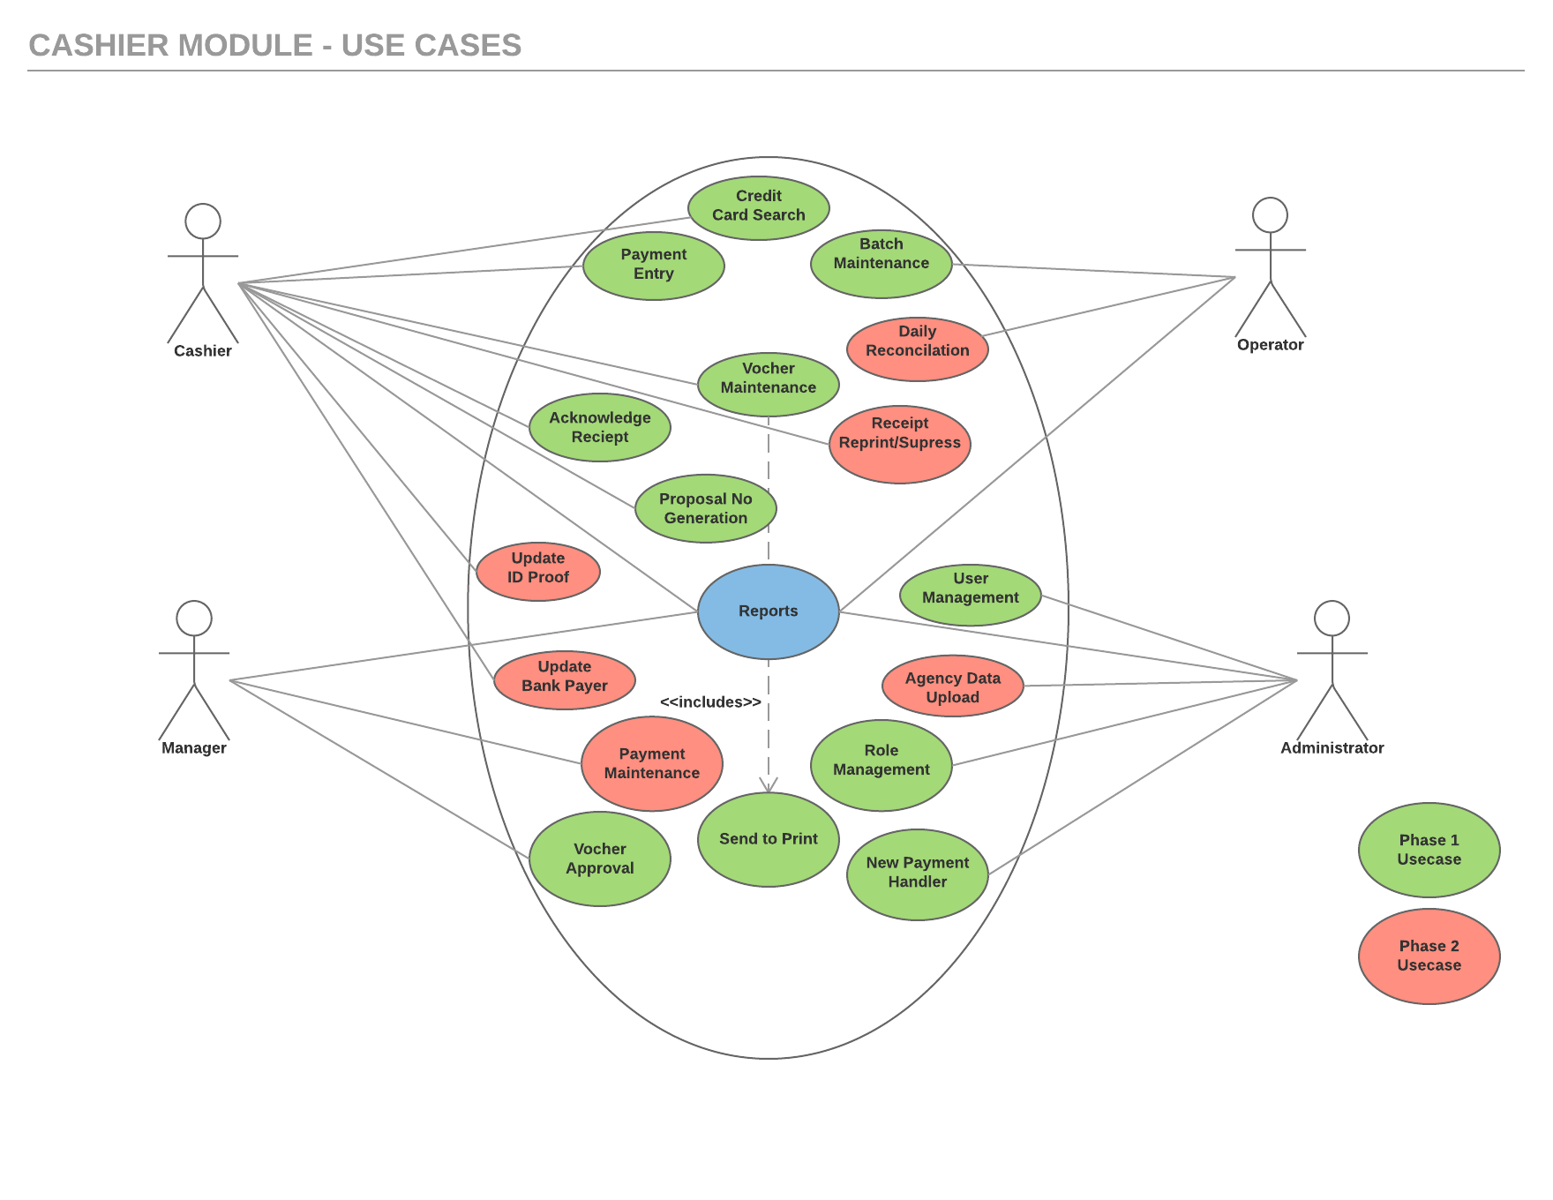
Notes:
Updated some content

Slide 8
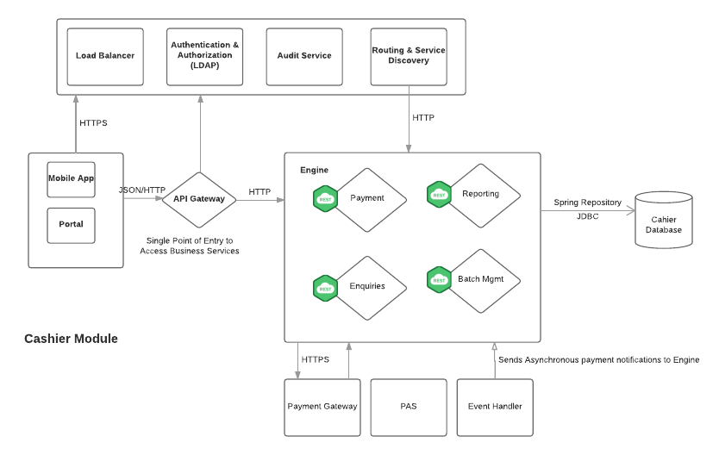
Functional View

Slide 9
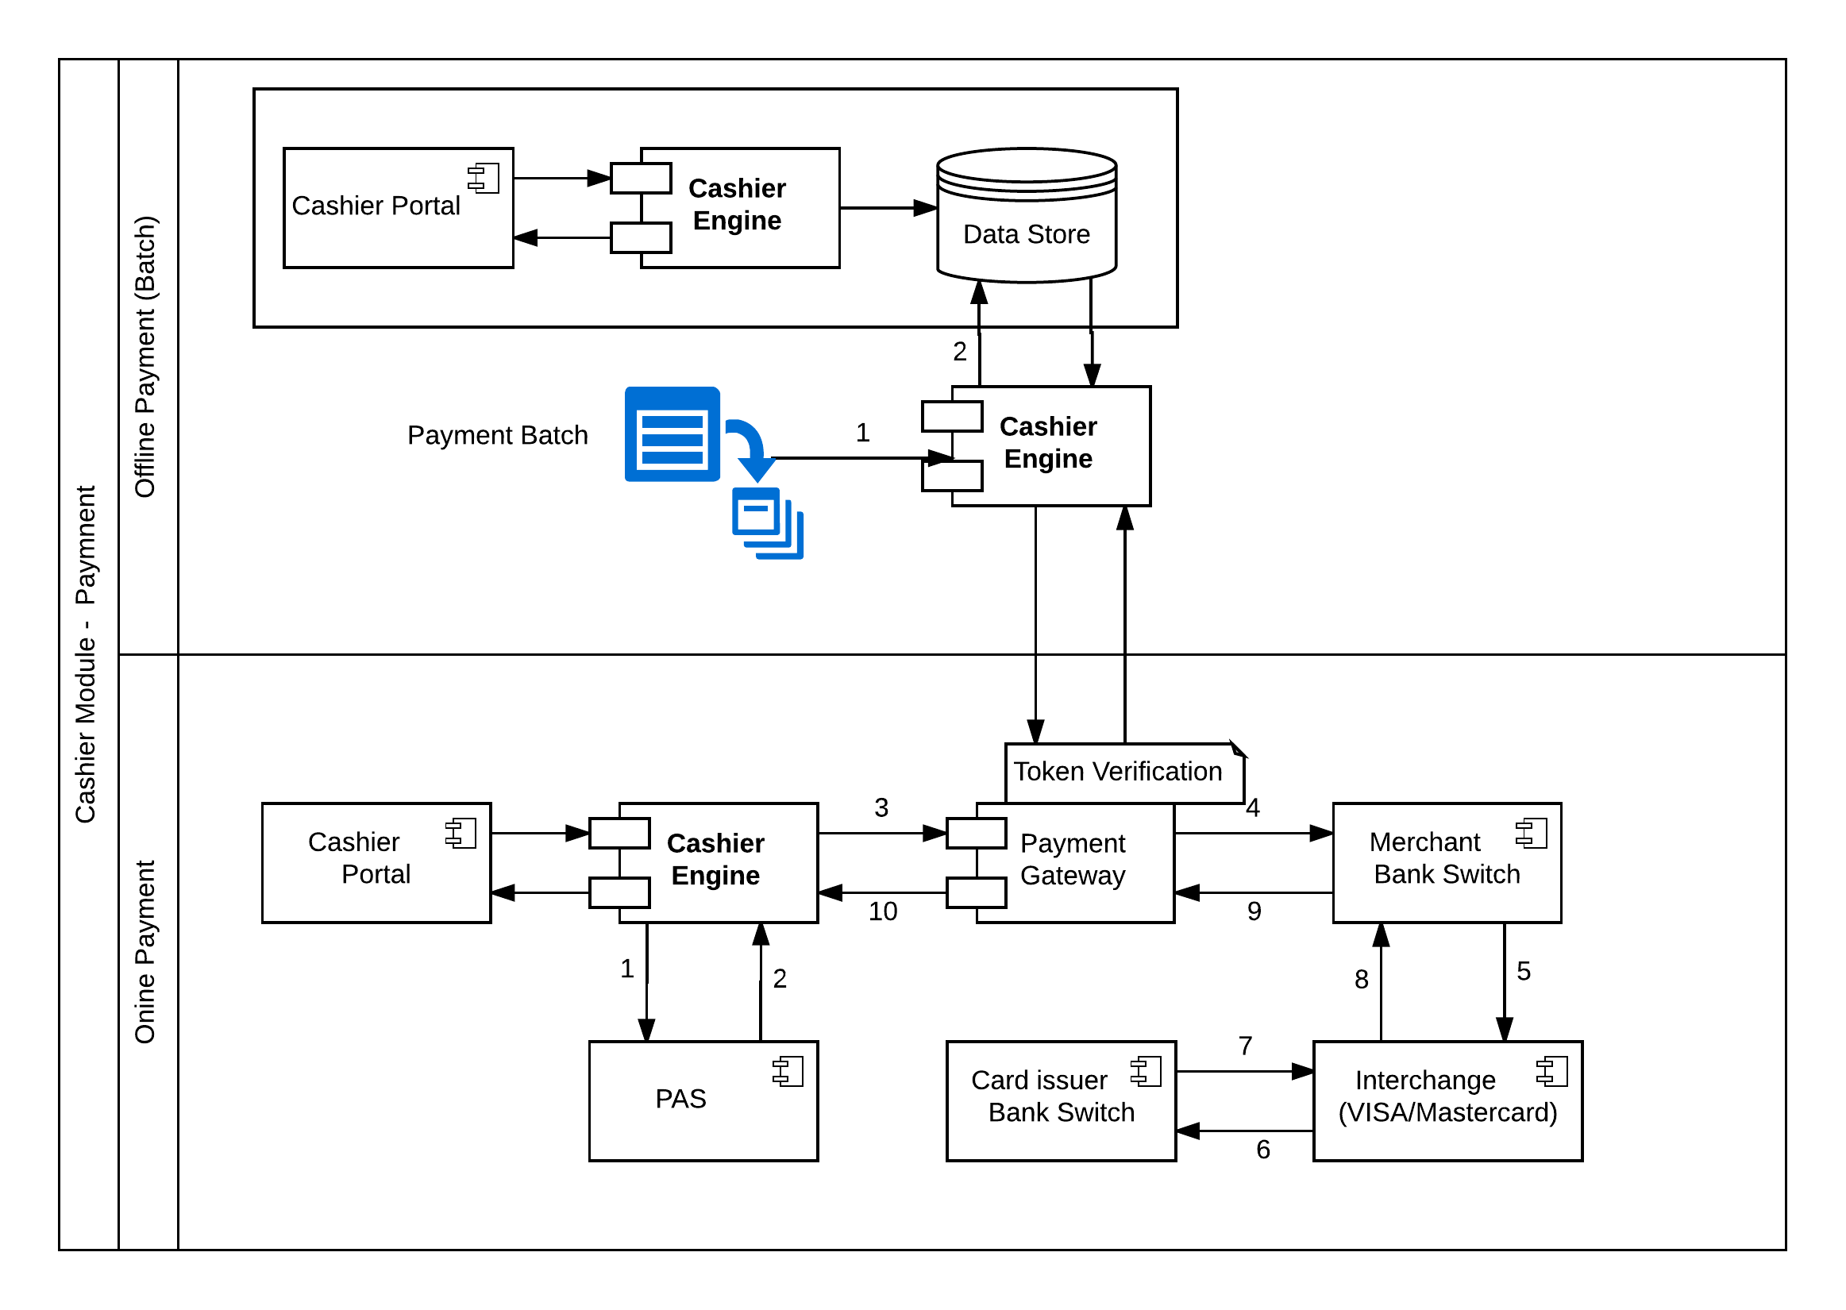
Data Flow Diagram

Slide 10
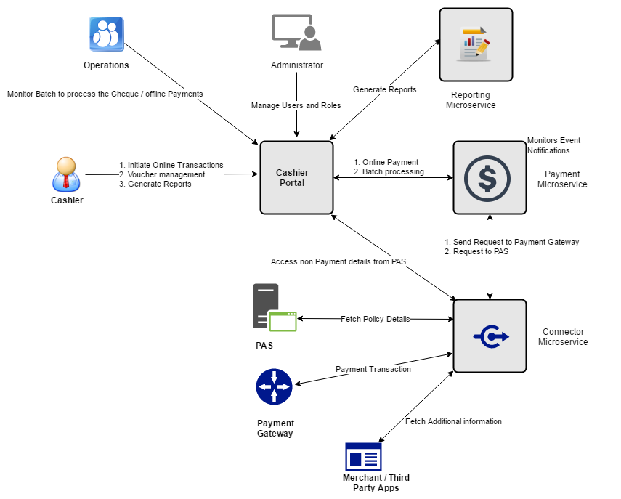
System context
Notes:
System Context:
The slide needs to include a representation of ALL the stakeholders, integrating systems, databases, depedency on other internal systems like centralized authentication, ESB, Data hub etc.
Use a diagram to define the boundaries around stakeholders, internal parts of the system, external and internal integrations, data exchange formats,

Slide 11
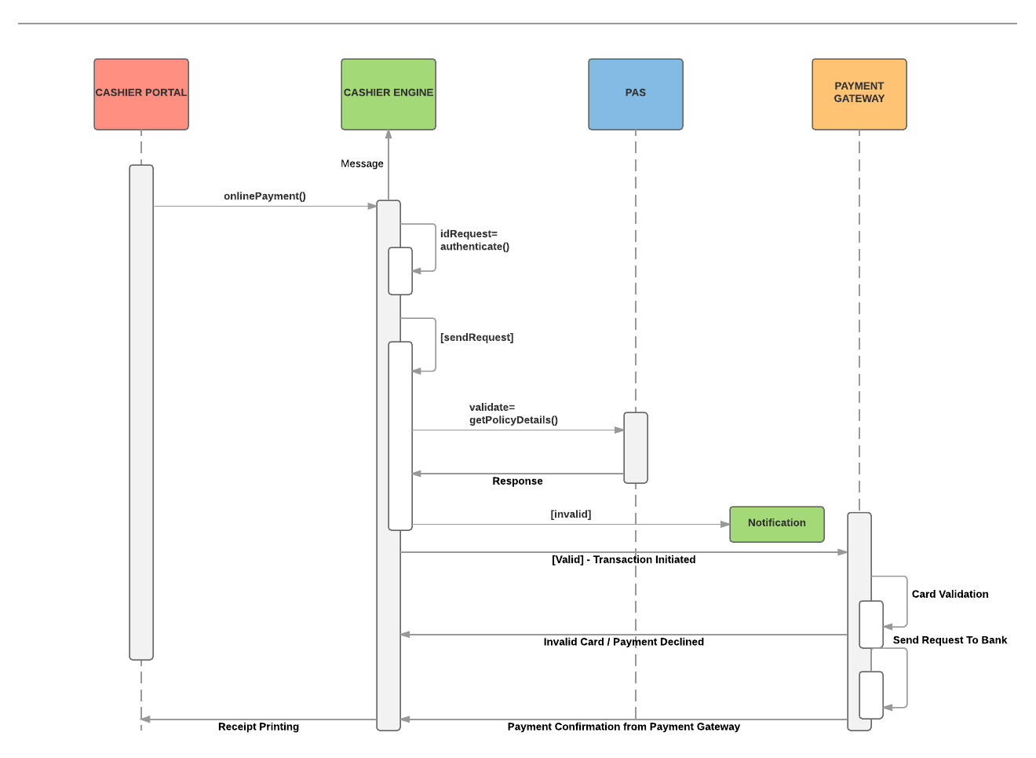
Logical View

Slide 12
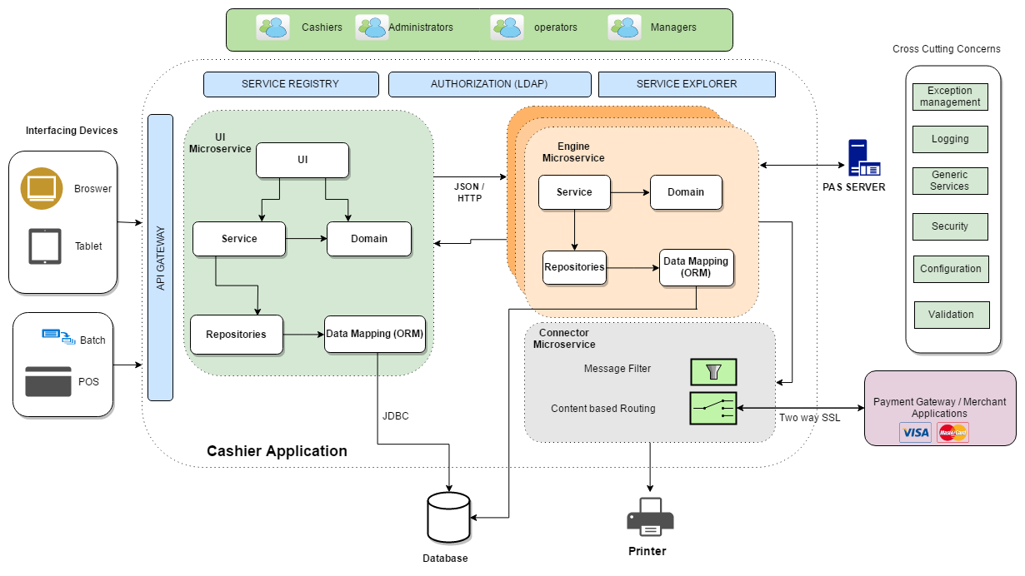
Application Architecture
Notes:
Application View:
Focus the view on presentation, business and data layer
Other layers can continue to be highlighted with less attention
Expand on the presentation, business and data layers to showcase how they are composed, modularized, specific/specialized NFR details applied
If integration heavy solution – represent how each individual integrations are processed, represent data exchanged, synchronous/asynchronous process, error handling
Can elaborate how certain cross cutting concerns are working together, depedencies between the cross cutting concerns with the layers etc.

Slide 13
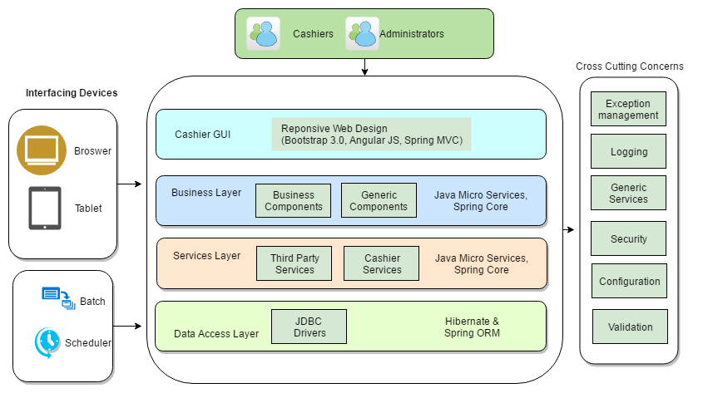
Application Architecture (Layered)
Notes:
Application View:
Focus the view on presentation, business and data layer
Other layers can continue to be highlighted with less attention
Expand on the presentation, business and data layers to showcase how they are composed, modularized, specific/specialized NFR details applied
If integration heavy solution – represent how each individual integrations are processed, represent data exchanged, synchronous/asynchronous process, error handling
Can elaborate how certain cross cutting concerns are working together, depedencies between the cross cutting concerns with the layers etc.

Slide 14
Technology Recommendation – Option 1
Technologies | Version/Details | Rationale
Application Server | Apache Tomcat 9.0 | Open Source Application Server and has complete support for Micro Services framework and will be suitable for cloud migration
Application Framework | Spring Framework / Service Discovery and Explorer, API Gateway using Spring Boot (Eureka Netflix) | Spring IOC has a feature to decouple the services and for logging AOP is a best option Netflix Discovery Server and Client option can be easily implemented using Spring boot
Java Platform | JDK 1.8.x
Data access | Hibernate 5.0.7
Database | Oracle 12g | Support for Distributed Transaction Management Support for Master-Master and Master-Slave Replication
Application Build | Gradle | Dependency Management is managed better than Maven and best suited with JDK 1.7+
Application Development | Eclipse IDE / Oxygen | In-Built support for Git, Gradle and Maven frameworks
CD/CI Tools | Git, Jenkins, Nexus
Static Code Analysis | SonarQube, PMD and Check style
Unit Testing Framework | JUnit, Mockito and PowerMock
Notes:
Technology Recommendation:
List technologies with version details, open source or commercial
Give few indications on why certain technologies are used as part of the solution.

Slide 15
Technology Recommendation – Option 2
Technologies | Version/Details | Rationale
Application Server | IBM WebSphere 8.5 | High Performance server and highly configurable server will be suitable to handle high throughput, Limited support for Scalability requirements
Application Framework | Spring framework 4.3.2 | Spring IOC has a feature to decouple the services and for logging AOP is a best option
Java Platform | JDK 1.8.x
Data access | Hibernate 5.0.7
Database | IBM DB2 | Support for Distributed Transaction Management Limited support for DB replication
Application Build | Maven | Simple and powerful tool for developers, fast learning curve
Application Development | IBM RAD 9.0 | Has built in plugins for Thread ,head dump analysis and IBM Coding Standard templates are availble
CD/CI Tools | Git, Jenkins, Nexus
Static Code Analysis | SonarQube, PMD and Check style
Unit Testing Framework | JUnit, Mockito and PowerMock
Notes:
Technology Recommendation:
List technologies with version details, open source or commercial
Give few indications on why certain technologies are used as part of the solution.

Slide 16
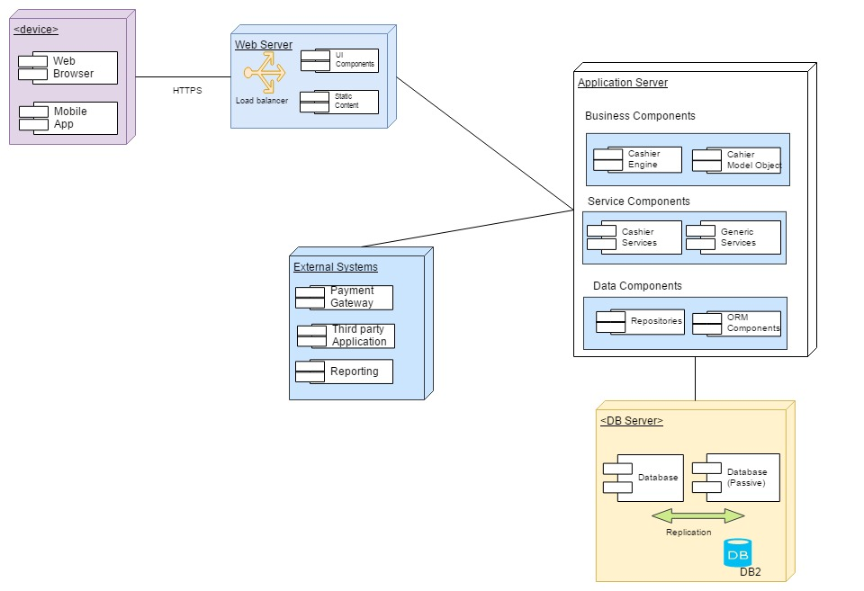
Deployment view
Notes:
Deployment View + Advantages of the deployment architecture:
Include firewalls, load balancers, failover, scaling design (application & database),
Represent external entities
Represent dependencies on use of internal enterprise systems that will be used
Represent highlights of the deployment as bullet points like fail over support, seasonal growth, cloud dependency etc

Slide 17
Advantages in Deployment Architecture
The grouping of components, and load balancers is offered to achieve scalability and availability
Additional instances can be added to the cluster in any of the tiers to distribute the load and reduce the response time, to have high volume of transactions
Each component is distributed to Multiple Tiers so that change in one layer will have no or very less impact on other layers
This solution has DB failover mechanism to achieve high availability
In future this solution can be implemented in cloud environment easily
Notes:
Deployment View + Advantages of the deployment architecture:
Include firewalls, load balancers, failover, scaling design (application & database),
Represent external entities
Represent dependencies on use of internal enterprise systems that will be used
Represent highlights of the deployment as bullet points like fail over support, seasonal growth, cloud dependency etc

Slide 18
NFRs identified and addressed in solution
Key non-functional requirements identified and addressed for the Prescription interpreter system are listed below:
Security
Interoperability
Framework
Portability
Scalability
Backup and Restore
Performance
Notes:
NFRs identified and addressed in the solution:
Use this slide to detail all the NFR identified and how the solution plans to address the same.
Group the NFR’s under solution highlights – headings like performance, security followed by listing the NFR – followed by the key solution highlights that will be used to address it.
Keep the solution highlights crisp – few bullet points and the details can be speaking points.

Slide 19
Solution Highlights
Key Requirements | Proposed Solution Highlights
Web Interface Compatible with tabs | Responsive Web design Frameworks would be used to create device specific responsive pages System would be designed to support mobile browsers of different sizes based on device specifics
Application instances for multiple regions | System would be designed with scalable, distributed data architecture for storing data System would be designed for load balanced REST API/Web interfaces
Cloud Hosting | System would be designed to support cloud hosting by following cloud specific patterns
Security | Authentication will be done LDAP Once Authenticated user will be authorized to access screens/menus based on role configured for the user
Notes:
Solution Highlights:
This slide must provide solution coverage from business and non functional, coming together with correct technology and deployment
This is more of a consolidation slide which should provide the client stakeholders repeat hearing of the solution highlights
Group the content under – business context – functionality, non-functionality, process. Under each heading highlight the critical requirements and few lines on technology enablement the success of the solution.
Repeat the key highlight messages – bold, use colors to ensure the slide has key messages, correct terminologies etc.
Each point mentioned in the Key drivers should be related and expanded in relevance to the solution in this slide

Slide 20
Appendix

Slide 21
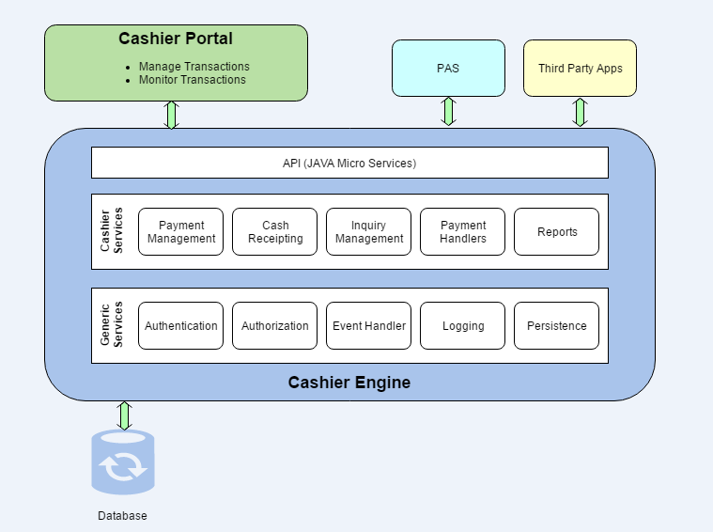
System context
Notes:
System Context:
The slide needs to include a representation of ALL the stakeholders, integrating systems, databases, depedency on other internal systems like centralized authentication, ESB, Data hub etc.
Use a diagram to define the boundaries around stakeholders, internal parts of the system, external and internal integrations, data exchange formats,

Slide 22
Release Plan
Sprint1 | Sprint2 | Sprint3 | Sprint4 | Sprint5 | Sprint6 | Sprint7 | Sprint8
Infrastructure Set Up, Process and Tool Readiness Screen Prototypes review | Screen Prototypes Feedback Receipt Printing Search, View results Payment Gateway Integration Login/Logout/Remember/Forgot Administration Page Integration of enterprise web service to get prescription details using dummy data |  | Application Information Panel Applicant’s conditional summary and detail screens Address Customer Feedback Integration of enterprise web service to get prescription details |  | Export and Print Capability Address Feedback User Acceptance Testing and address feedback |  | Rollout and Support Documentation

Slide 23
Acronyms
GUI - Graphical User Interface
PAS - Policy Administration System
MIB - Medical Information Bureau
M.D. - Doctor of Medicine
IIS - Internet Information Services
HLD - High Level Design
LLD - Low Level Design
DB - Database
JS - Java Script

Slide 24
Thank You!!!

